Slide 1

PI and Thermal Simulation Study for BD95861MUV Board
January 07th, 2014
Hosted by: Xuan Dang

Slide 2
Agenda
Introduction
DC Drop Analysis
Current Density Analysis
Thermal Analysis
Conclusion

Slide 3
Introduction
This work considers power simulation and thermal simulation on BD95861MUV boards.
Based on board file BD95861MUVEVK-101_EVAL_BRD_REV02_20140107_1800.brd
Hyperlynx v8.2.1 and Hyperlynx Thermal v9.1 (MentorGraphic) software is used for simulation
PI simulation considers:
DC Drop analysis
Determine what the max drop for power rail
Current Density analysis
Determine the hot spot of current density on PCB
Thermal simulation considers:
PCB temperature profile including consideration for conductive, radiative, and convective heat transfer

Slide 4
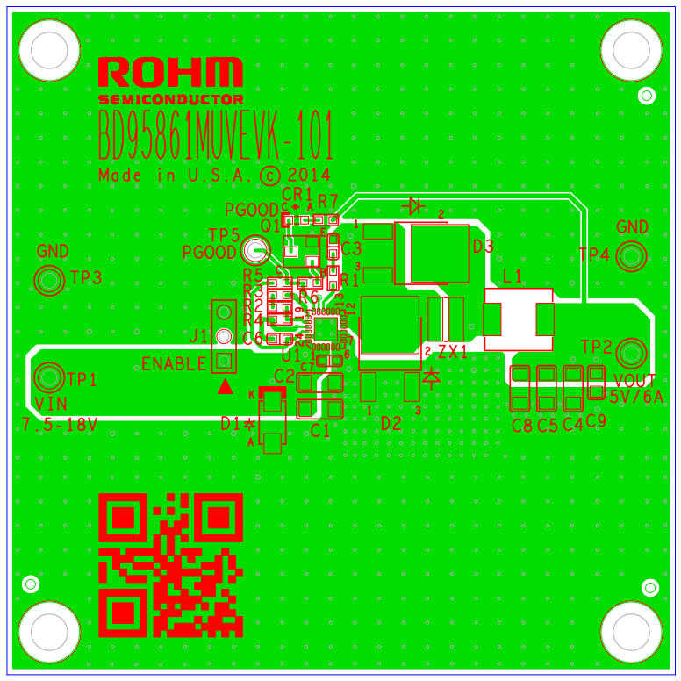
BD95861MUV Board
Based on the board file : BD95861MUVEVK-101_EVAL_BRD_REV02_20140107_1800.brd
Vin 5V/div (DC)

Slide 5
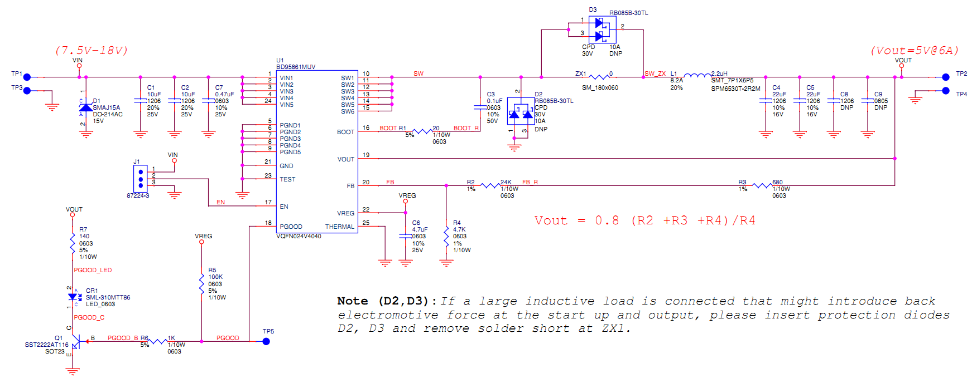
BD95861MUV Schematic
Based on the schematic file : BD95861MUV_EVAL_SCH_REV02_20140107_1800.pdf

Slide 6
BD95861MUV Board power consumption
Device/rail | Source/VRM refdes | Source PCB netname | Sink/load PCB refdes | Load PCB net name | Nominal Voltage(V) | Voltage tolerance (%) | Max current (A) | Power input (W) | Power consumption (W) | Note
Power input via TP1/TP3 connectors (VIN 7.5-18V) | TP1 | VIN | U1 | VIN | 7.50 |  | 5.00 | 37.50 |  | Max input current = (Pout + PONH + PONL + PL)/VIN = 4.44A with Vin =7.5V (worst condition). So we choose max input current =5A to simulate power/thermal
Power dissipation on BD95861MUV internal FETs | TP1 | VIN | U1 | VIN |  |  | 6.00 |  | 3.12 | RONH=0.1 Ohm; RONL=0.06 Ohm
Power dissipation on inductor L1 | ZX1 | SW | L1 | SW_ZX |  |  | 6.00 |  | 0.68 | RL = 0.019 Ohm
Power consumption at load via connector TP2/TP4 (VOUT 5V) | L1 | VOUT | TP2 | VOUT | 5 | 2 | 6.00 |  | 30.00
 |  |  |  |  |  |  | Total | 37.50 | 33.80

Slide 7
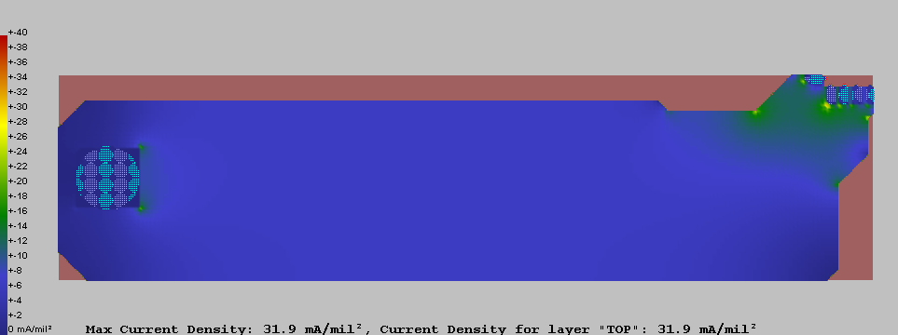
Current Density analysis for VIN7.5V@5A
Source TP1
Load U1
Max Current Density 31.9mA/mil² < 40mA/mil² (This rule limit 10 ⁰C of temperature rise above ambient) → Copper planes for VIN is OK

Slide 8
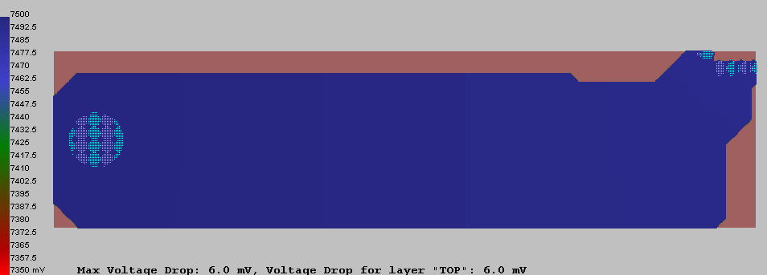
DC Drop analysis for VIN7.5V@5A
Source TP1
Load U1
Max DC Drop 6.0mV < 150mV (2% tolerance of 7.5V) → Copper planes for VIN is OK

Slide 9
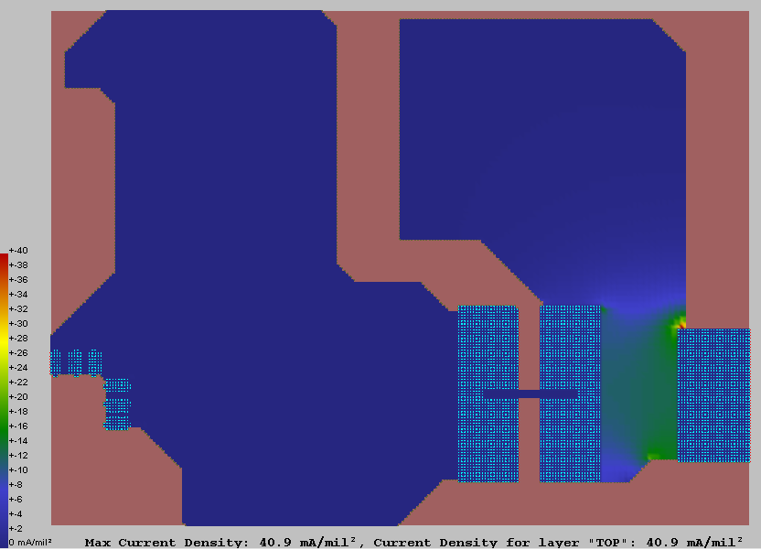
Current Density analysis for SW@6A
Source U1
Solder-shorted ZX1
Load L1
Max Current Density 40.9mA/mil² ~ 40mA/mil² (This rule limit 10 ⁰C of temperature rise above ambient) → Copper plane for SW is OK

Slide 10
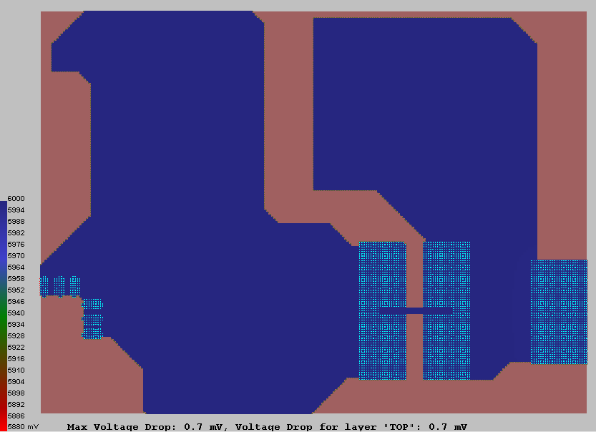
DC Drop analysis for SW@6A
Source U1
Solder-shorted ZX1
Load L1
Max DC Drop 0.7 mV < 120mV (2% tolerance of assumption voltage 6V) → Copper planes for SW is OK

Slide 11
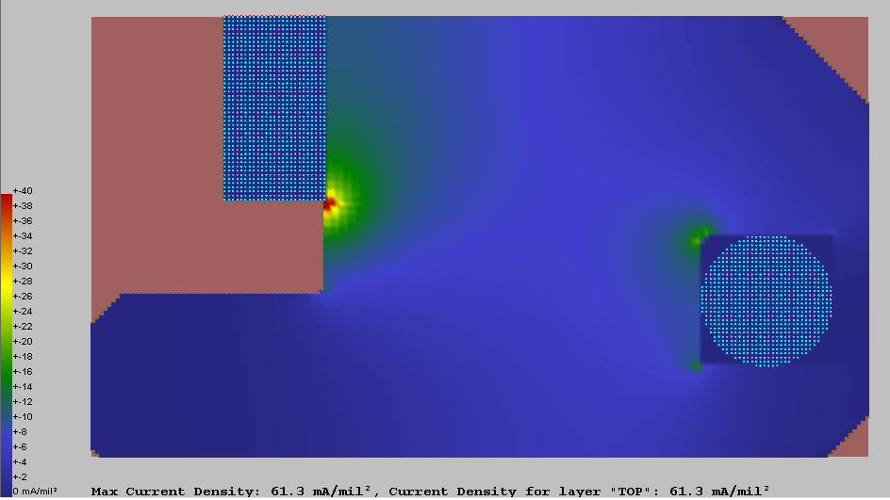
Current Density analysis for VOUT 5V@6A
Source L1
Load TP2
Max Current Density 61.3mA/mil² > 40mA/mil² (This rule limit 10 ⁰C of temperature rise above ambient) → We reduced VOUT’s current density as possible

Slide 12
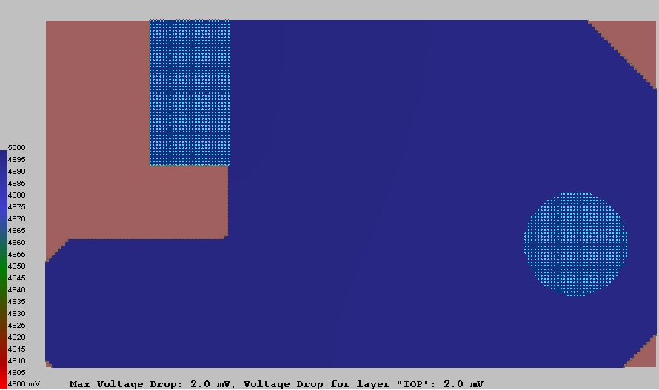
DC Drop analysis for VOUT 5V@6A
Source L1
Load TP2
Max DC Drop 2.0 mV < 100mV (2% tolerance of 5V) → Copper planes for VOUT is OK

Slide 13
Thermal Analysis
Environment conditions
Air Temperature : 25 ⁰C , 35 ⁰C and 45 ⁰C
Air Pressure: 1 atm
Gravity: 1
Humidity ratio: 0.5%
No incoming air flow (Natural convection)
Emissivity of board: 1
Board location : single board
System: closed
SW 5V/div

Slide 14
Thermal Analysis (Con’t)
Component properties
 | BD96861MUV | SPM6530T-2R2M | RB085B-30TL (Diode D3) | SML-310MTT86 | SST2222AT116
Number of pins | 25 | 2 | 3 | 2 | 3
Pin length | 0.028” | 0.134” | 0.063 | 0.032 | 0.05
Pin width | 0.012” | 0.073” | 0.019 | 0.032 | 0.04
Pin thickness | 0.009” | 0.006 | 0.02 | 0.01 | 0.005
Pin thermal conductivity | 223.031Btu/hrftF | 223.031Btu/hrftF | 223.031Btu/hrftF | 223.031Btu/hrftF | 223.031Btu/hrftF
Max. power dissipation | 3.12 W (at Vin=7.5V) 2.76W (at Vin=12V) | 0.684 W | 2.88 W | 0.044 W | 0.012 W
VOUT 20mV/div (AC)
SW 5V/div

Slide 15
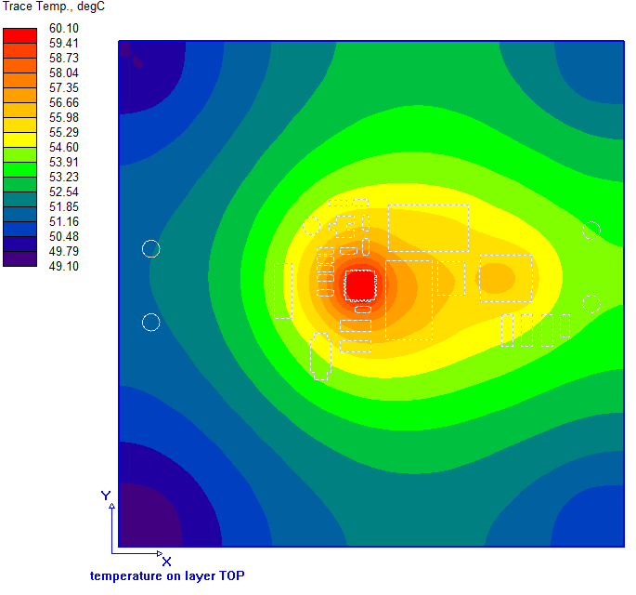
Thermal Analysis (Con’t)
Air temperature 25⁰C, power dissipation of BD95861MUV is 3.12W (at VIN=7.5V), exclude power dissipation of DNP diode D3 RB085B-30TL
U1: BD95861MUV
Max. power dissipation: 3.12 W @VIN=7.5V
Component temperature = 70 ⁰C
L1: SPM6530T-2R2M
Max. power dissipation: 0.684 W
Component temperature = 56.7 ⁰C
D3
D3:RB085B-30TL
Component temperature = 55.5 ⁰C
U1
L1
The highest temperature on board is about 60.1 ⁰C
The highest temperature on component is on BD95861MUV ( about 70 ⁰C)

Slide 16
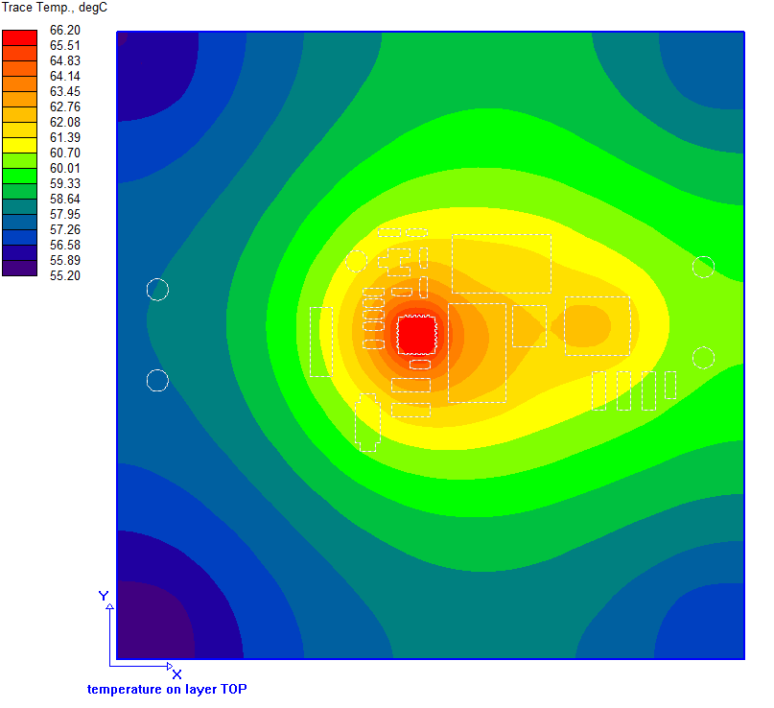
Thermal Analysis (Con’t)
Air temperature 35⁰C, power dissipation of BD95861MUV is 3.12W (at VIN=7.5V), exclude power dissipation of DNP diode D3 RB085B-30TL
U1: BD95861MUV
Max. power dissipation: 3.12 W @VIN=7.5V
Component temperature = 76.2 ⁰C
L1: SPM6530T-2R2M
Max. power dissipation: 0.684 W
Component temperature = 62.8 ⁰C
D3
D3:RB085B-30TL
Component temperature = 61.7 ⁰C
U1
L1
The highest temperature on board is about 66.2 ⁰C
The highest temperature on component is on BD95861MUV ( about 76.2 ⁰C)

Slide 17

Thermal Analysis (Con’t)
Air temperature 45⁰C, power dissipation of BD95861MUV is 3.12W (at VIN=7.5V), exclude power dissipation of DNP diode D3 RB085B-30TL
U1: BD95861MUV
Max. power dissipation: 3.12 W @VIN=7.5V
Component temperature = 82.4 ⁰C
L1: SPM6530T-2R2M
Max. power dissipation: 0.684 W
Component temperature = 69 ⁰C
D3
D3:RB085B-30TL
Component temperature = 67.9 ⁰C
U1
L1
The highest temperature on board is about 72.4 ⁰C
The highest temperature on component is on BD95861MUV ( about 82.4 ⁰C)

Slide 18
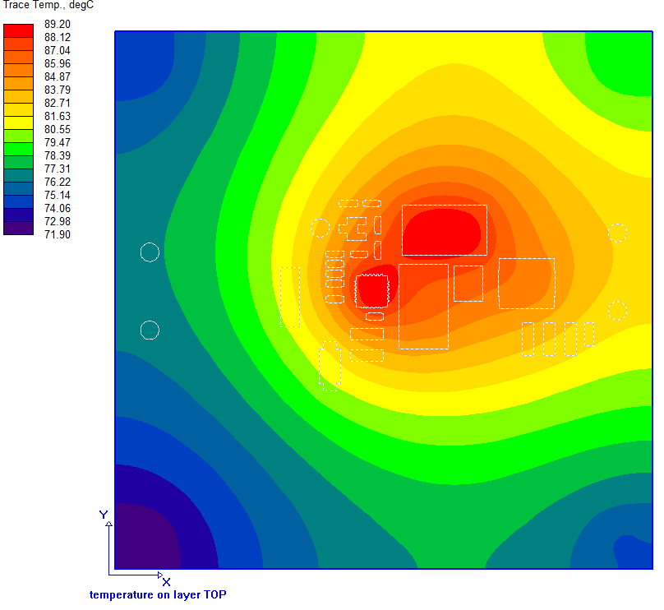
Thermal Analysis (Con’t)
Air temperature 25⁰C, power dissipation of BD95861MUV is 3.12W (at VIN=7.5V), include power dissipation of DNP diode D3 RB085B-30TL
U1: BD95861MUV
Max. power dissipation: 3.12 W @VIN=7.5V
Component temperature = 98.9 ⁰C
L1: SPM6530T-2R2M
Max. power dissipation: 0.684 W
Component temperature = 86.2 ⁰C
D3
D3:RB085B-30TL
Max. power dissipation: 2.88 W
Component temperature = 90.3 ⁰C
U1
L1
The highest temperature on board is about 89.2 ⁰C
The highest temperature on component is on BD95861MUV ( about 98.9 ⁰C)

Slide 19
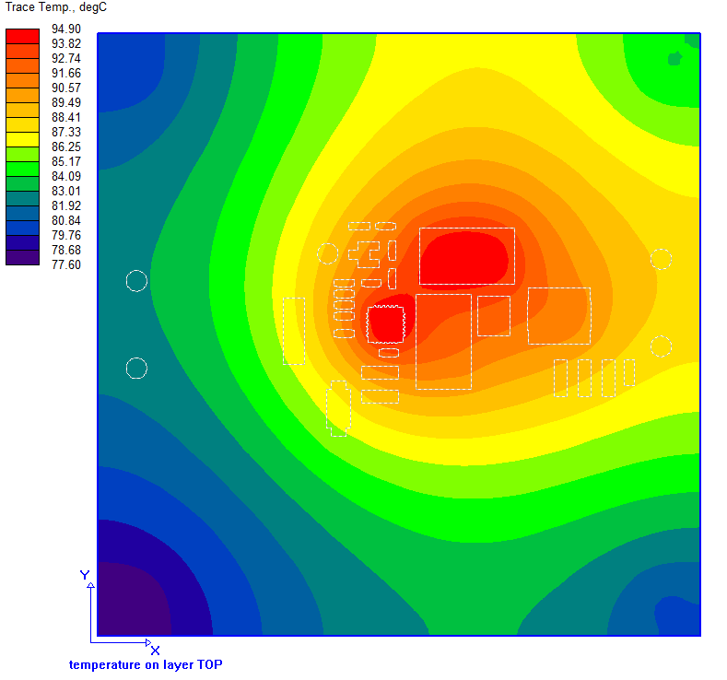
Thermal Analysis (Con’t)
Air temperature 35⁰C, power dissipation of BD95861MUV is 3.12W (at VIN=7.5V), include power dissipation of DNP diode D3 RB085B-30TL
U1: BD95861MUV
Max. power dissipation: 3.12 W @VIN=7.5V
Component temperature = 104.7 ⁰C
L1: SPM6530T-2R2M
Max. power dissipation: 0.684 W
Component temperature = 91.9 ⁰C
D3
D3:RB085B-30TL
Max. power dissipation: 2.88 W
Component temperature = 96 ⁰C
U1
L1
The highest temperature on board is about 94.9 ⁰C
The highest temperature on component is on BD95861MUV ( about 104.7 ⁰C)

Slide 20
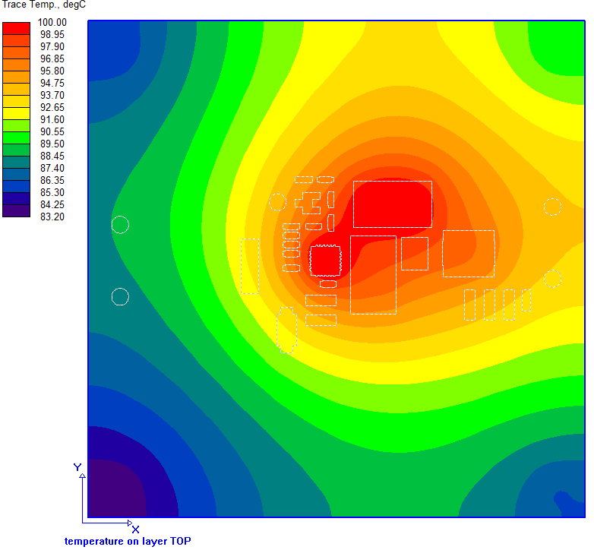
Thermal Analysis (Con’t)
Air temperature 45⁰C, power dissipation of BD95861MUV is 3.12W (at VIN=7.5V), include power dissipation of DNP diode D3 RB085B-30TL
U1: BD95861MUV
Max. power dissipation: 3.12 W @VIN=7.5V
Component temperature = 110.3 ⁰C
L1: SPM6530T-2R2M
Max. power dissipation: 0.684 W
Component temperature = 97.6 ⁰C
D3
D3:RB085B-30TL
Max. power dissipation: 2.88 W
Component temperature = 101.7 ⁰C
U1
L1
The highest temperature on board is about 100 ⁰C
The highest temperature on component is on BD95861MUV ( about 110.3 ⁰C)

Slide 21
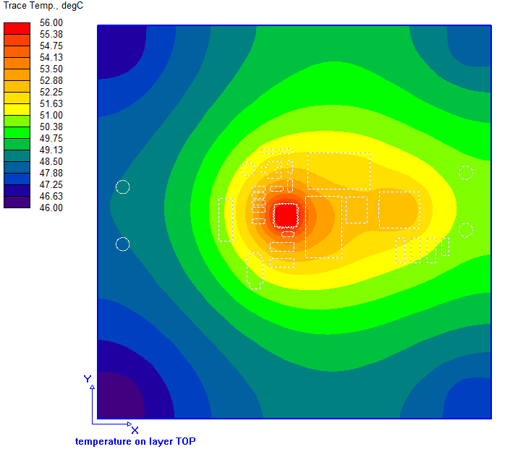
Thermal Analysis (Con’t)
Air temperature 25⁰C, power dissipation of BD95861MUV is 2.76 W (at VIN=12V), exclude power dissipation of DNP diode D3 RB085B-30TL
U1: BD95861MUV
Max. power dissipation: 2.76 W @VIN=12V
Component temperature = 64.8 ⁰C
L1: SPM6530T-2R2M
Max. power dissipation: 0.684 W
Component temperature = 53.3 ⁰C
D3
D3:RB085B-30TL
Component temperature = 52 ⁰C
U1
L1
The highest temperature on board is about 56 ⁰C
The highest temperature on component is on BD95861MUV ( about 64.8 ⁰C)

Slide 22
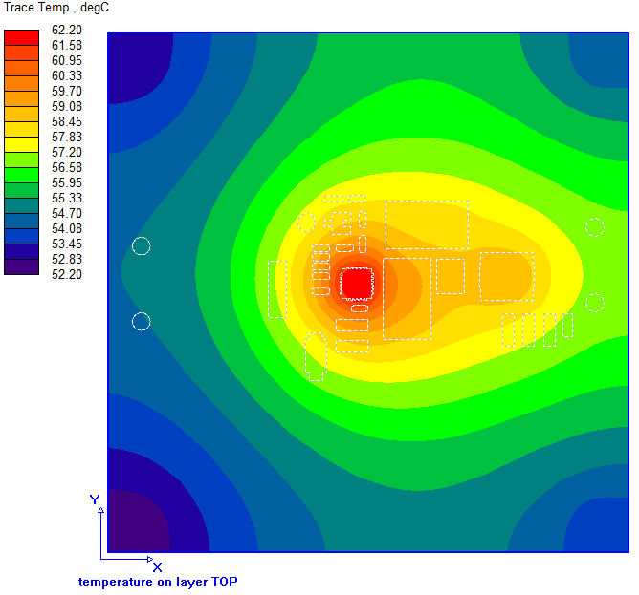
Thermal Analysis (Con’t)
Air temperature 35⁰C, power dissipation of BD95861MUV is 2.76 W (at VIN=12V), exclude power dissipation of DNP diode D3 RB085B-30TL
U1: BD95861MUV
Max. power dissipation: 2.76 W @VIN=12V
Component temperature = 71 ⁰C
L1: SPM6530T-2R2M
Max. power dissipation: 0.684 W
Component temperature = 59.5 ⁰C
D3
D3:RB085B-30TL
Component temperature = 58.2 ⁰C
U1
L1
The highest temperature on board is about 62.2 ⁰C
The highest temperature on component is on BD95861MUV ( about 71 ⁰C)

Slide 23
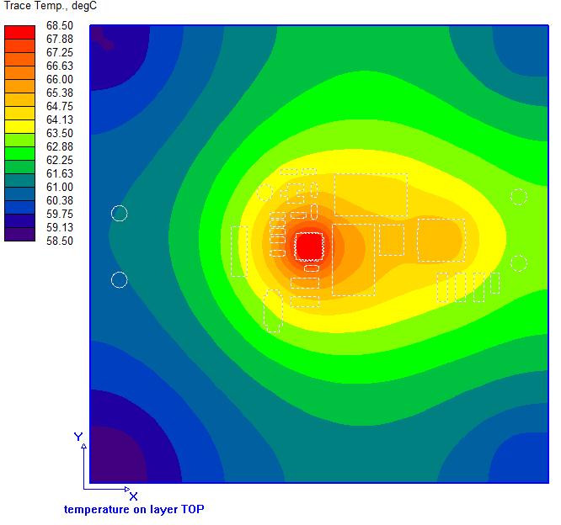
Thermal Analysis (Con’t)
Air temperature 45⁰C, power dissipation of BD95861MUV is 2.76 W (at VIN=12V), exclude power dissipation of DNP diode D3 RB085B-30TL
U1: BD95861MUV
Max. power dissipation: 2.76 W @VIN=12V
Component temperature = 77.3 ⁰C
L1: SPM6530T-2R2M
Max. power dissipation: 0.684 W
Component temperature = 65.8 ⁰C
D3
D3:RB085B-30TL
Component temperature = 64.5 ⁰C
U1
L1
The highest temperature on board is about 68.5 ⁰C
The highest temperature on component is on BD95861MUV ( about 77.3 ⁰C)

Slide 24
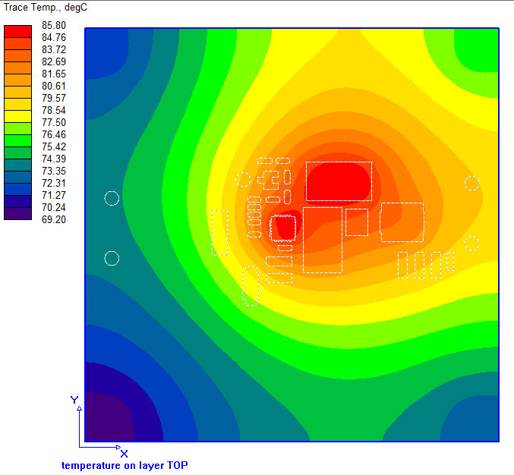
Thermal Analysis (Con’t)
Air temperature 25⁰C, power dissipation of BD95861MUV is 2.76 W (at VIN=12V), include power dissipation of DNP diode D3 RB085B-30TL
U1: BD95861MUV
Max. power dissipation: 2.76 W @VIN=12V
Component temperature = 94.1 ⁰C
L1: SPM6530T-2R2M
Max. power dissipation: 0.684 W
Component temperature = 83.2 ⁰C
D3
D3:RB085B-30TL
Max. power dissipation: 2.88 W
Component temperature = 87.2 ⁰C
U1
L1
The highest temperature on board is about 85.8 ⁰C
The highest temperature on component is on BD95861MUV ( about 94.1 ⁰C)

Slide 25
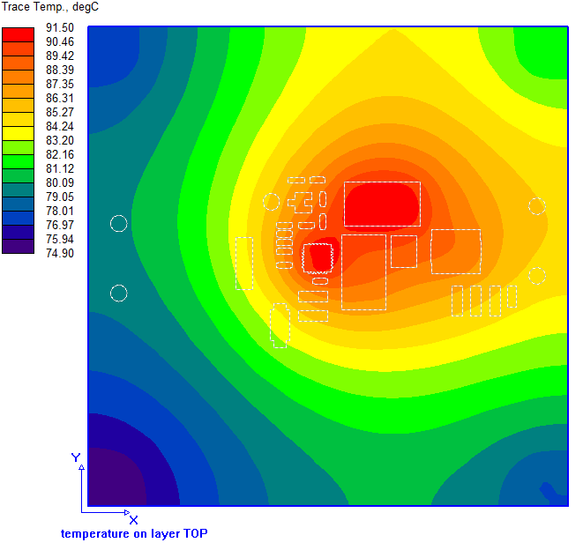
Thermal Analysis (Con’t)
Air temperature 35⁰C, power dissipation of BD95861MUV is 2.76 W (at VIN=12V), include power dissipation of DNP diode D3 RB085B-30TL
U1: BD95861MUV
Max. power dissipation: 2.76 W @VIN=12V
Component temperature = 99.8 ⁰C
L1: SPM6530T-2R2M
Max. power dissipation: 0.684 W
Component temperature = 88.9 ⁰C
D3
D3:RB085B-30TL
Max. power dissipation: 2.88 W
Component temperature = 92.9 ⁰C
U1
L1
The highest temperature on board is about 91.5 ⁰C
The highest temperature on component is on BD95861MUV ( about 99.8 ⁰C)

Slide 26
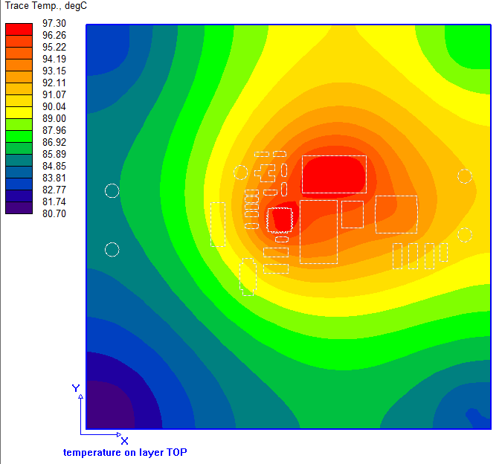
Thermal Analysis (Con’t)
Air temperature 45⁰C, power dissipation of BD95861MUV is 2.76 W (at VIN=12V), include power dissipation of DNP diode D3 RB085B-30TL
U1: BD95861MUV
Max. power dissipation: 2.76 W @VIN=12V
Component temperature = 105.6 ⁰C
L1: SPM6530T-2R2M
Max. power dissipation: 0.684 W
Component temperature = 94.7 ⁰C
D3
D3:RB085B-30TL
Max. power dissipation: 2.88 W
Component temperature = 98.7 ⁰C
U1
L1
The highest temperature on board is about 97.3 ⁰C
The highest temperature on component is on BD95861MUV ( about 105.6 ⁰C)

Slide 27
Summary
The PI simulation shows that the max. amount voltage drop of VIN power is 6.0mV, the max. current density of VIN power is 31.9mA/mil²; the max. amount voltage drop of SW power is 0.7mV, the max. current density of SW power is 40.9mA/mil²; the max. amount voltage drop of VOUT power is 2.0mV, the max. current density of VOUT power is 61.3mA/mil²
The highest temperature of BD95861MUV can be reached temperature as table below:
 | VIN=7.5V |  | VIN=12V
 | D2, D3: not install | D2, D3: install | D2, D3: not install | D2, D3: install
Air temperature: 25⁰C | 70 ⁰C | 98.9 ⁰C | 64.8 ⁰C | 94.1 ⁰C
Air temperature: 35⁰C | 76.2 ⁰C | 104.7 ⁰C | 71 ⁰C | 99.8 ⁰C
Air temperature: 45⁰C | 82.4 ⁰C | 110.3 ⁰C | 77.3 ⁰C | 105.6 ⁰C

